Slide 1
3.1
Boolean Expressions

Slide 2
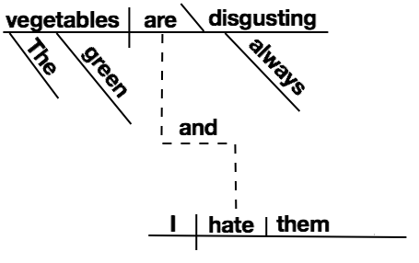
Programming Language Grammar
Before we talk about boolean expressions, let's talk about grammar, which is what expressions are part of.
Expressions are part of Java's grammar. Programming languages have grammar just like natural languages… but they're made up of different elements than nouns, verbs, adjectives, etc.
Three of the elements in Java's grammar are:
Expressions
Statements
Blocks

Slide 3
Expressions
An expression is a construct made up of variables, operators, and method invocations, which are constructed according to the syntax of the language, that evaluates to a single value.
Examples:
false
2+2
1.0/2.0
“Hello, world”
player.getLocation()
System.out.println(“Hello, world”)
x + y == 4
x = 2

Slide 4
Expressions
An expression evaluates to a single value, and that value has a type.
Examples:
false – boolean
2+2 – int
1.0/2.0 – double
“Hello, world” – String
player.getLocation() – Room
System.out.println(“Hello, world”) – void
x + y == 4 – boolean
x = 2 – int, if x is type int

Slide 5
Statements
Statements are roughly equivalent to sentences in natural languages. A statement forms a complete unit of execution.
The body of a method is a series of statements.
Examples:
System.out.println("Hello, world!");
return Math.sqrt((x2-x1)*(x2-x1) + (y2-y1)*(y2-y1));
player.setLocation(player.getLocation()).getNorth());
x = 3;

Slide 6
Expression Statements
A lot of the statements we've used are expressions with a semicolon at the end.
These are called Expression Statements.
Examples:
System.out.println("Hello, world!");
return Math.sqrt((x2-x1)*(x2-x1) + (y2-y1)*(y2-y1));
player.setLocation(player.getLocation()).getNorth());
x = 3;
(The return is not an Expression Statement but still has an expression in it.)

Slide 7
Blocks
A block is a group of zero or more statements between balanced braces and can be used anywhere a single statement is allowed.
{
statement1
statement2
…
statementN
}

Slide 8
Blocks
This means you could write
public class Main { public static void main(String args[]) { { { { System.out.println(“Hello, world”); } } } } }
You wouldn’t, but you could!

Slide 9
Syntactically (in)significant whitespace
Java statements are terminated by semicolons. Java blocks are delimited by {}.
Whitespace (\n, \t, space) in Java is syntactically insignificant. (Not Python!)
These programs are equivalent:
public class Hello {
public static void main(String args[]) {
System.out.println("Hello, world!");
}
}
public class Hello{public static void main(String args[]){System.out.println("Hello, world!");}}
We indent Java code nicely to make it readable for programmers… but Java is indifferent. Code can even be deliberately obfuscated.

Slide 10
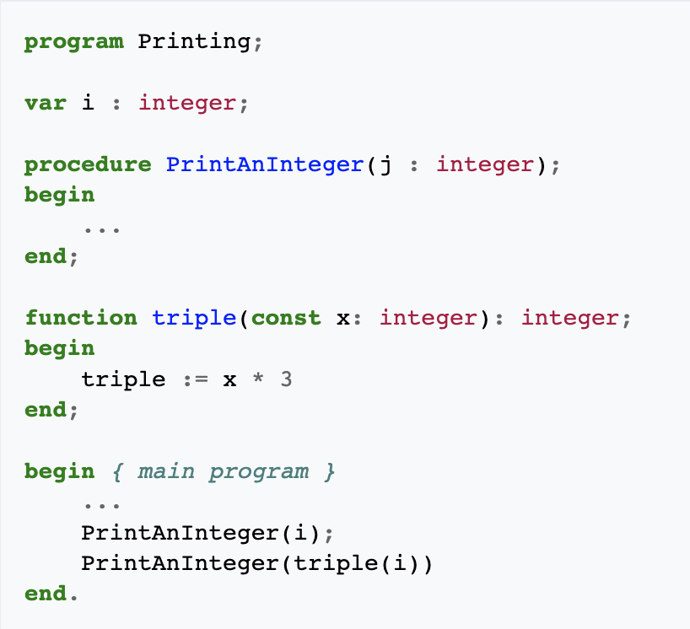
Heritage of ; and {}
Back in the 90s, AP Comp Sci was taught in Pascal… Note "begin" and "end" became "{" and "}" in C/C++/Java Statements end in semicolons, and the whole program ends with a period, like an English sentence.

Slide 11
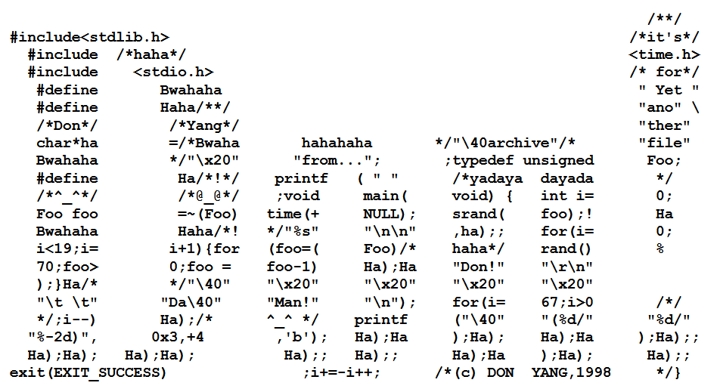
International Obsfucated C Code Contest (IOCCC)

Slide 12
Boolean Expressions
A boolean expression is any expression that evaluates to type boolean. Boolean expressions are important for control flow.
The simplest boolean expressions are simply
true
false
… but most boolean expressions use boolean operators

Slide 13
Equality Operators
x == y | true if x is equal to y, false otherwise
x != y | true if x is not equal to y, false otherwise
Keep in mind that you must use "==", not "=", when testing if two values are equal.
= is the assignment operator and will assign the value of y to x!

Slide 14
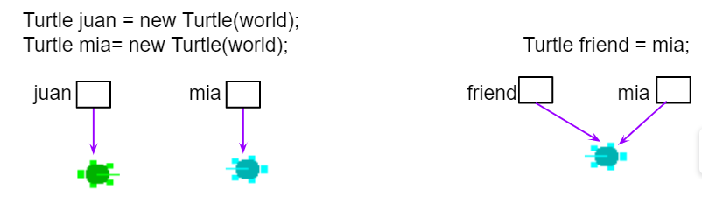
Equality Operators
For object types, == and != compare whether the two sides are references to the same object… not whether anything else about the objects are equal, such as the characters in two Strings.
For Strings, remember to use equals() and not the == or != operators.

Slide 15
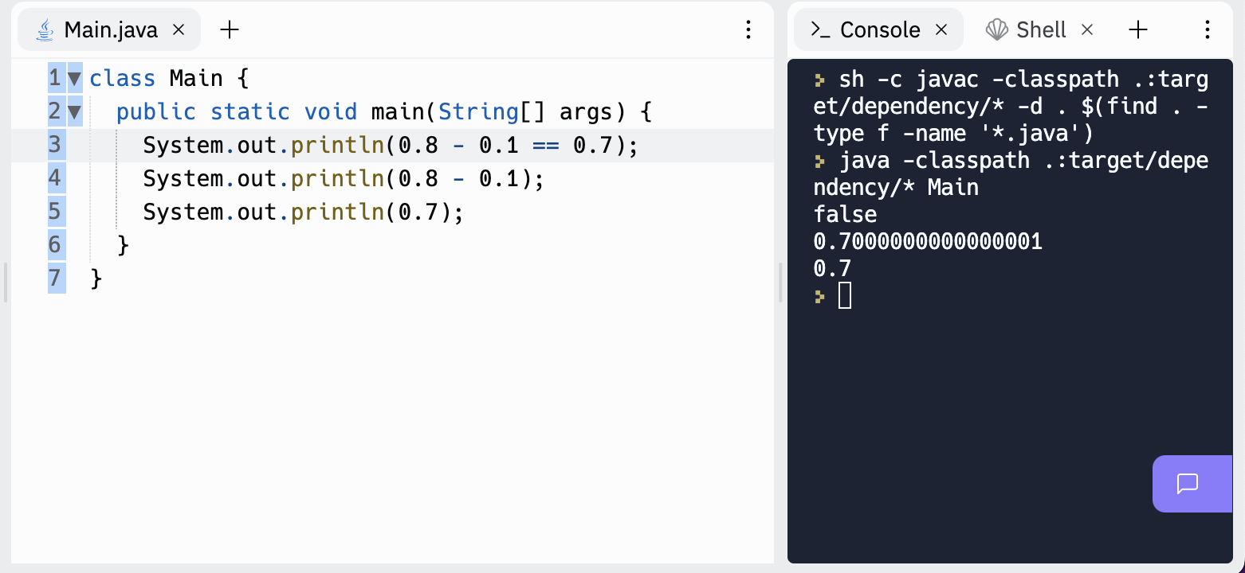
Equality Operators
Even primitive types can surprise you…
0.1 is terminating in decimal, but repeats forever in binary: 0.000110011…
Financial applications use "binary coded decimals" instead of float / double types to avoid this "round off error".

Slide 16
Equality Operators: operand types
The equality operators may be used to compare two operands that are convertible (§5.1.8) to numeric type, or two operands of type boolean or Boolean, or two operands that are each of either reference type or the null type. All other cases result in a compile-time error.
String string1="x", string2="y";
double double1=1.0, double2=2.0;
int int1=1, int2=2;
boolean boolean1=false, boolean2=true;
System.out.println(string1 == string2); // Allowed but usually not what you want
System.out.println(double1 == int1); // Allowed, both are numeric
System.out.println(boolean1 == int1); // Compile time error
System.out.println(string1 == int1); // Compile time error

Slide 17
Relational Operators
x > y | true if x is greater than y, false otherwise
x < y | true if x is less than y, false otherwise
x >= y | true if x is greater than or equal to y, false otherwise
x <= y | true if x is less than or equal to y, false otherwise
Tip: To remember >= and <=, think of it as the order in which you say it. Greater than (>) or equal to (=)

Slide 18
Relational Operators
x > y | true if x is greater than y, false otherwise
x < y | true if x is less than y, false otherwise
x >= y | true if x is greater than or equal to y, false otherwise
x <= y | true if x is less than or equal to y, false otherwise
These don't work on objects, such as Strings! This is where you use the String.compareTo method.
(compareTo isn't part of Object like equals - it comes from the Comparable interface.)

Slide 19
Nesting of Expressions
Operators in Java like == and < take operands. The operands are themselves expressions. Expressions thus can nest inside other expressions.
expression statement
expression of type boolean
expression of type boolean
expression of type double
expression of type double
distance(x1, y1, x2, y2) * 0.25 < game.getMaxCollisionDistance() - 10.0
;
collided =

Slide 20
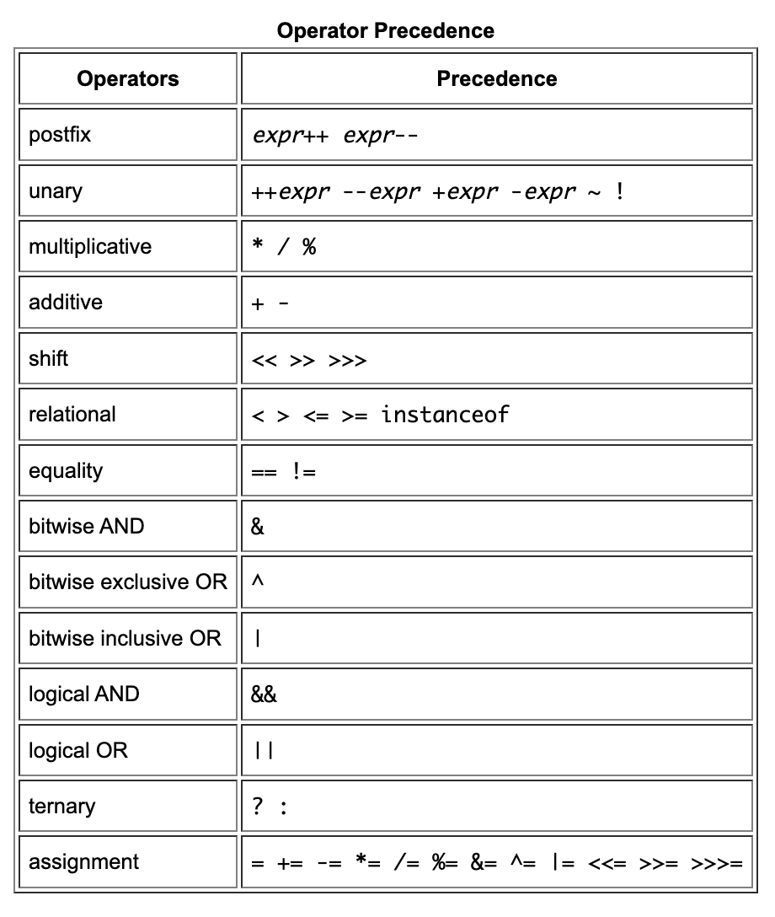
Operator Precedence
Java has an order in which it evaluates operators, just like PEMDAS tells you to multiply/divide before adding/subtracting when doing math.
So x + 2 < y + 3 and (x+2) < (y+3) are equivalent because + has higher precedence than <.
When in doubt, use parentheses, and sometimes it's best to add parentheses to make code more readable.

Slide 21
Modulo Operator (%)
x % y | returns the remainder of dividing x by y
This is NOT a boolean operator, but it's a handy one frequently used with operators like ==. % works on integers but also on floats/doubles in Java.
One use is checking whether a number is even or odd.
x % 2 == 0 means x is even
x % 2 == 1 means x is odd
You can use it to check if a number is an even multiple of another:
x % y == 0 means x is a multiple of y (can be divided by y with a remainder of 0)

Slide 22
3.2
if statement

Slide 23
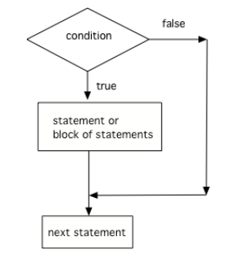
Let's put those booleans to work!
// Condition if (boolean expression) { // Statement or block of statements Do statement; } // Next statement Do statement;

Slide 24
Pro-tip: Always use { } in your if statements
Not advised:
if (boolean expression)
Do statement;
Better:
if (boolean expression) {
Do statement;
}
Note: This is something we call "style". A programming style is a set of programming conventions and best practices. Consistently following a basic Java style will help you avoid errors and mistakes.

Slide 25
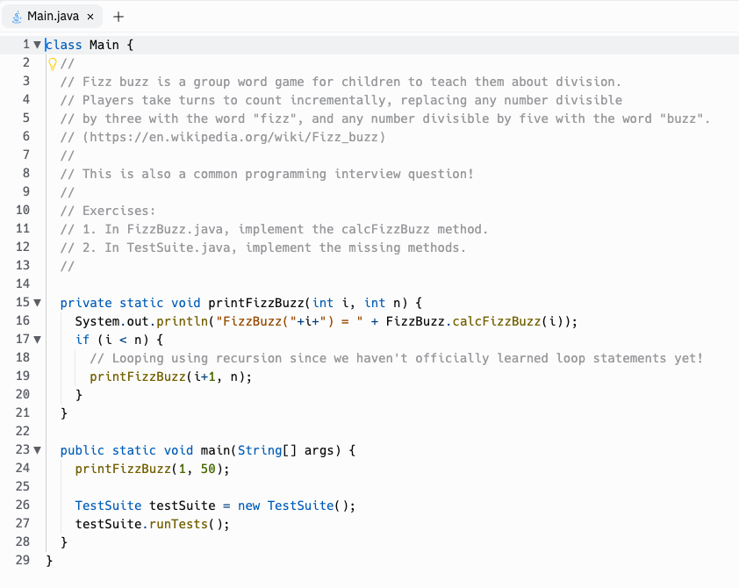
Practice!
Replit: fizzbuzz

Slide 26
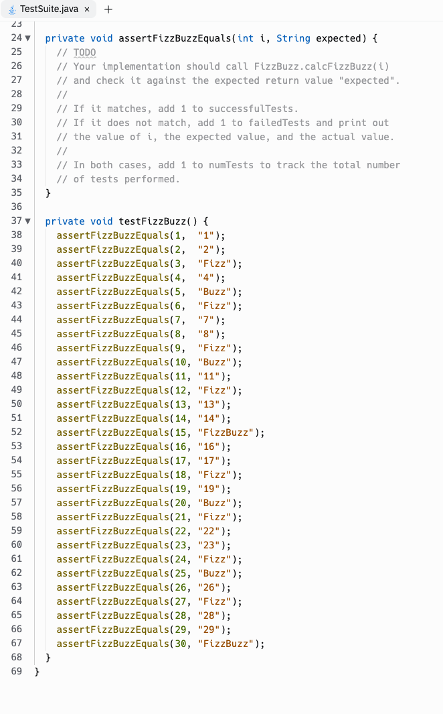
TDD (Test Driven Development)

